Slide 1
鉴识项目 & 过程模型
SHAO Jian
jshao@zju.edu.cn
College of Computer Science and Technology
Zhejiang University

Slide 2
鉴别和选项择目

Slide 3
Learning Objectives
识别、选择、开始和计划项目的描述步骤
项目视图指南
为评估项目可行性做多种方案描述
解释项目的有形和无形成本/收益
解释项目的经常性和一次性成本
细述成本/收益分析的各种方法

Slide 4
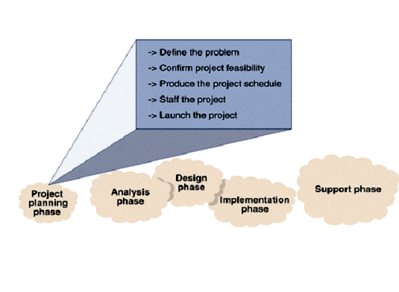
The Project Planning Phase
SDLC
Activities of the project planning phase.

Slide 5
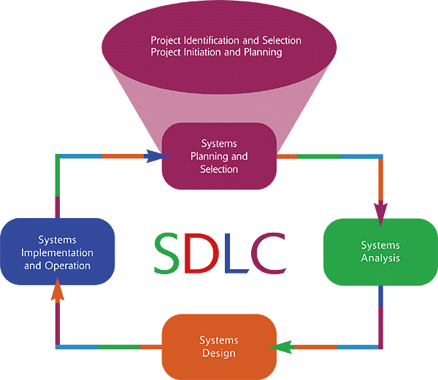
鉴别和选择项目
*

Slide 6
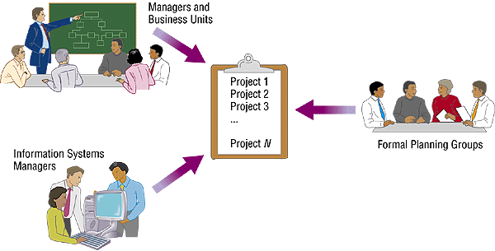
鉴别和选择项目
识别有发展潜力的项目
Where do projects come from?
一切为了寻找合适的项目

Slide 7
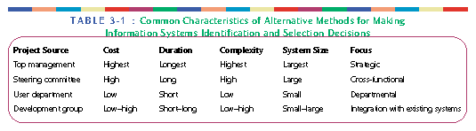
鉴别和选择项目
1. 两种方法：
Top Down Identification
  Senior management or steering committee
  Focus is on global needs of organization
Bottom up Identification
  Business unit or IS group
  Don’t reflect overall goals of the organization

Slide 8
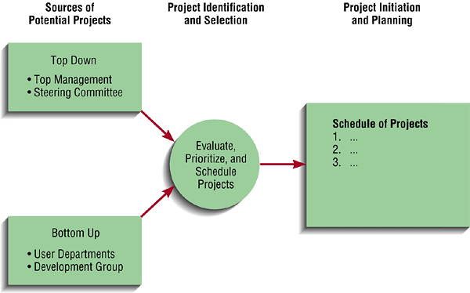
鉴别和选择项目
分类有发展潜力的项目
价值链分析
战略联盟
潜在利益
可用资源
项目持续期限/规模
技术难点/风险

Slide 9
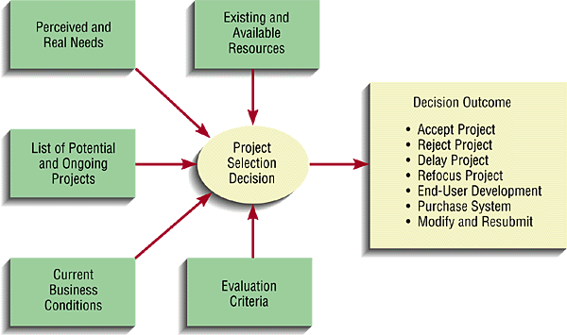
鉴别和选择项目
选择有发展潜力的项目

Slide 10
鉴别和选择项目
提交结果
Primary deliverable of this phase is a schedule of specific IS development projects
Another outcome is a policy of Incremental commitment
  Continuous reassessment of project after each phase

Slide 11
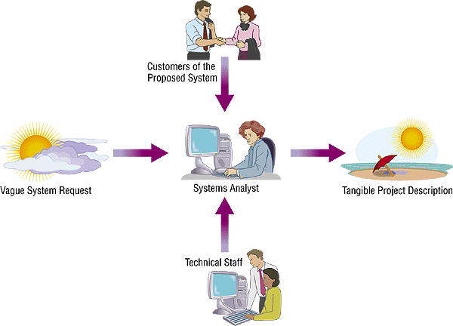
Initiating and Planning System
项目进展
项目计划基线Baseline Project Plan (BPP)
  生成内部文档
工作说明书Statement of Work (SOW)
  为项目编制目标大纲和约束条件

Slide 12
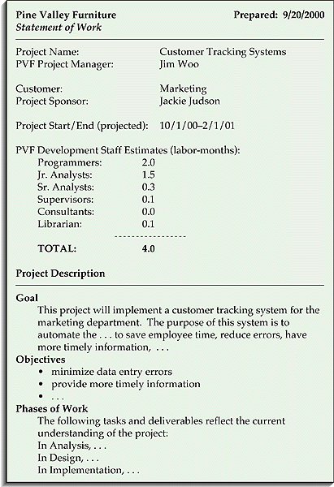
Identifying and Selecting Projects: 提交结果
Baseline Project Plan (BPP)
  Scope范围
  Benefits效益
  Costs成本
  Risks风险
  Resources资源
Statement of Work (SOW)
  Describes deliverables描述可交付成果
  Outlines work needed to be performed完成项目大纲必须履行的任务

Slide 13
Project Vision Guidelines
项目视图指南
考虑项目的利益相关者、风险和必要的赢利
从你的视角观察项目完整的生命周期
你可以一如既往的通过视图和团队沟通
允许团队成员使用不同的视图，只要这样做不影响到项目的成功
寻找“一条通往成功的路”，使之称为你的视图的一部分
当你修改你的视图时，应该形成一份新版视图给团队成员
在软件项目大纲中，你的视图文档将可能称为软件文档计划

Slide 14
Project Vision Guidelines
项目视图指南
考虑项目的利益相关者、风险和必要的赢利
  你的视图文档和表格应该包含：
    All the stakeholders利益相关者
    All the risks风险.
    All project, process, and product needs.
    All the tradeoffs权益.
    All the payoffs应付成本.

Slide 15
Project Vision Guidelines
项目视图指南
通过视图和团队沟通.
  你的团队通常都是通过项目视图来了解你的意图.
  你一般都会用文档、曲线图、图表和其它合适的手段来让和团队沟通.

Slide 16
Project Vision Guidelines
项目视图指南
允许团队成员在使用视图时存在差异.
  这些不同视图可以被用来对不同团队做不同的风险评估, 工作成果评估, 复杂性评估, 或团队工作能力评估.
  其中的差异反映了团队的实力，可以成为促进他们进步的动力.

Slide 17
Project Vision Guidelines
项目视图指南
项目视图文档.
  建立一个软件项目大纲( Software Project Outline, SPO)其中包含了有关系统需求的高层描述、项目规模和人员需求等.
  SPO 将回答以下问题： who, what, where, when, how.
  保持 SPO的简洁、明了和易读(通常是5-10页).

Slide 18

项目可行性评估过程
必须结合
企业策略
SWOT Analysis
External
Environment
审视或修正
任务
Internal
Environment
目的 &
目标
Competitive
Environment
高层决策者
贯彻到项目
策略描述
2013春夏学期授课版
*

Slide 19
为一体化和健壮性而进行的项目甄选

Slide 20
“Whether or not to go ahead with a project”
对项目甄选的可行性评估是基于：
  Existing Strategies已有策略
  Technical criteria技术标准
  Economic criteria经济标准
  Risk involved风险相关
Project = 其完整的生命周期是从想法到实施完成的全过程.

Slide 21
项目一体化和健壮性
项目收益
正常理由
& 期待
利益相关者
项目
健壮性
客户机的问题或需求
组织策略 &
基础

Slide 22
Project Selection
项目甄选是对单个或多个项目进行的评估
是项目规划的重要方面
是对组织目标的配置
采用定量和定性相结合的方法
由管理层根据开发组织的背景决定采用适合的方法甄选项目

Slide 23
Primary issues in selection of a project?

Slide 24


多数人
意见优先
利益相关者
关注的焦点
资源
利用
Project
Selection
Issues
变更
控制
风险
平衡
选择的公开性

Slide 25
Project Selection Models

Slide 26
甄选模型的标准
Realism真实性 - reality of manager’s decision
Capability可能性- able to simulate different scenarios and optimize the decision
Flexibility适应性 - provide valid results within the range of conditions
Ease of Use易用性 - reasonably convenient, easy execution, and easily understood

Slide 27
甄选模型的标准
Cost成本 - Data gathering and modeling costs should be low relative to the cost of the project
Easy Computerization易实现性 - must be easy and convenient to gather, store and manipulate data in the model
Used成熟 – the model is used to select projects – not support decisions already made

Slide 28
Issues in Project Selection Models
Models do not make decisions决心 - People do!
Models only support the decision making process
There is always a model used for decision

Slide 29
Issues in Project Selection Models
所有模型都仅仅只能反映事物真实面貌的部分
模型在“度量”潜在项目时，还应该对比一些相对的评估参量
还要记住，决定总是两面的，而不仅仅是“Y”或“N”

Slide 30
项目甄选模型的本性
什么是选择正确的模型?
模型有2个基本的类型
  数字
  非数字
所有模型都能度量
  项目的合适性
  给与项目相关的因素“定序”

Slide 31
Nonnumeric Project Selection Models

Slide 32
非数字模型－列举6种
Sacred Cow不可变 - project is suggested by a senior and powerful official in the organization
Operating Necessity工作需要 - the project is required to keep the system running
Competitive Necessity竞争需要 - project is necessary to sustain a competitive position

Slide 33
非数字模型－列举6种
Product Line Extension产品线扩展 - projects are judged on how they fit with current product line, fill a gap, strengthen a weak link, or extend the line in a new desirable way.
Comparative Benefit Model (Q-sort method)利益比较 - several projects considered, select the one with the most benefit to the firm
The Murder Board 质疑委员会– panel of reviewers scrutinizes a set of proposals to show how it is not workable. Project champion gets to defend argue for proposal.

Slide 34
Which “Method” is This?
A group of reviewers challenges the project proponent
Hospital considers addition of new service because of decreased market share
Senior manager says we should introduce a new technology
WHAT ARE THE STRENGTHS AND WEAKNESSES OF NON-NUMERIC SELECTION MODELS?

Slide 35
evaluation is based on评估基础：
  Existing Strategies已有策略
  Technical criteria技术标准
  Economic criteria经济标准
  Risk involved风险相关

Slide 36
策略评估
Strategy策略, Tactic战略, Operation操作 – Analogy to Football match
  Strategy=Using 4-3-3 system (aggressive attacking)
  Tactic=How to play as a team according to 4-3-3
  Operation=To resolve the situational problems.
项目管理层的管理水平怎样?
组织的战略利益
  Overall business objectives商业目标
  Information strategy [CIO]信息策略
  Programme strategy (collection of projects) [programme director]
  Individual project strategy单个项目的策略

Slide 37
Technical Assessment技术方法评估
Evaluate the required function against HW and SW available.
  Organization with strategic info plan may limit the nature of solutions
    Such constraints will influence the cost of solution
    This must be taken into account in the cost-benefit analysis.

Slide 38
Economic assessment经济评估
Standard way of evaluating econ. benefits of project is the Cost-benefit analysis
Two steps:
  识别和评估所有的成本和收益
    Development costs
    Expected accrual of Operating costs and the Benefits
    For a replacement, only the net in change are counted.
      A new order processing sys., can claim only the increase of sales due to the use of its.
  明确公共环节的成本和利益
      E.g. in monetary terms.

Slide 39
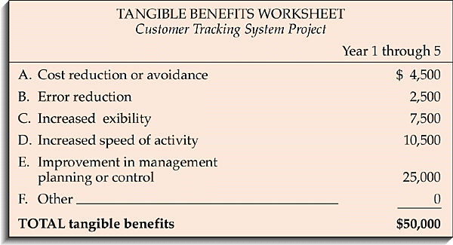
评估经济可行性：成本/效益分析
有形收益
  Can be measured easily
    Cost reduction and avoidance
    Error reduction
    Increased flexibility
    Increased speed of activity
    Increased management planning and control
无形收益
  Cannot be measured easily
    Increased employee morale
    Competitive necessity
    More timely information
    Promotion of organizational learning and understanding

Slide 40
评估经济可行性：成本/效益分析
有形成本
  Can easily be measured in dollars
    Example: Hardware
无形成本
  Cannot be easily measured in dollars
  Examples:
    Loss of customer goodwill
    Loss of employee morale

Slide 41
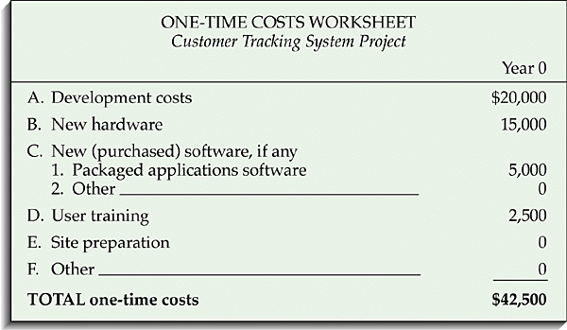
评估经济可行性：成本/效益分析
一次成本 -- Associated with project startup, initiation and development
*

Slide 42
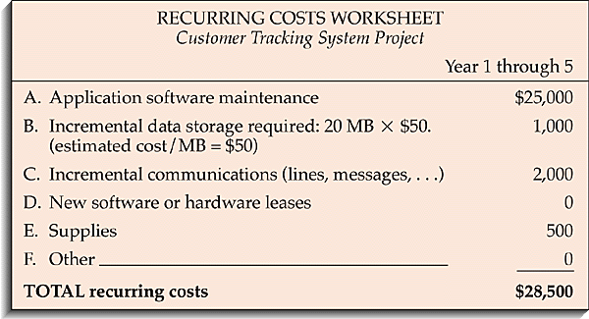
评估经济可行性：成本/效益分析
重复成本 -- Associated with on-going use of the system
*

Slide 43
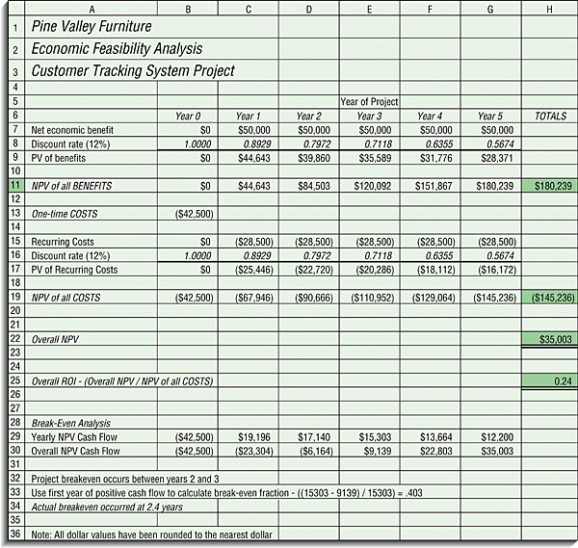
经济可行性评估
Time value of money (TVM)资金的时间价值
  The process of comparing present cash outlays to future expected returns.
+
Various Techniques不同手法
  Net present value (NPV)
  Return on investment (ROI)
  Break-even analysis (BEA)
*

Slide 44
Numeric Project Selection Models
- Profitability收益率
- Scoring回报

Slide 45
Numeric Models:
Profit利润/Profitability收益率
Financial considerations are often “the” primary decision criteria for project selection财务通常是项目选择时第一考虑的要旨

Slide 46
Cash flow prediction现金流预测
收入
成本

Slide 47
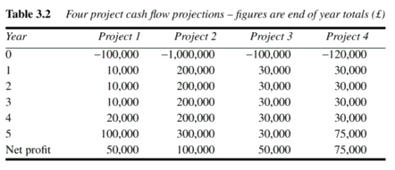
Cash flow prediction现金流预测

Slide 48
Numeric Models:
Profit利润/Profitability收益率
Three primary methods for determining the projected financial value of projects:项目财务评估的三种主要方法：
  Net Profit
  Net present value (NPV) analysis现值分析
  Return on investment (ROI)投资收益
  Payback analysis回收期分析

Slide 49
Return on Investment投资收益法
Return on investment (ROI) is income divided by investment收入/投资
  ROI = (total discounted benefits - total discounted costs) / discounted costs
The higher the ROI, the better
Many organizations have a required rate of return or minimum acceptable rate of return (MARR) on investment for projects

Slide 50
Net Present Value Analysis
现值分析法
Net present value (NPV) analysis – calculates the expected net monetary gain or loss from a project by discounting all expected future cash inflows and outflows to the present point in time计算项目预期某个时间点的现金进出量
Positive NPV - should consider selection of the project if financial value is a key criterion
The higher the NPV, the better!

Slide 51
Payback Period Analysis
回收期分析法
Payback Period - the amount of time it will take to recoup dollars invested in a project
Payback occurs when the cumulative discounted benefits and costs are greater than zero收入和投资相抵的时间
Shorter the payback period the better

Slide 52
Numeric Modeling Issues
Focus only on the measurable/tangible焦点落在可测量的/有形资产
Adequacy of specification of model模型规范合适
Subjective – Objective – Subjective dilemma主观-客观-主观两难
  Problem Formulation问题简述
  Analytical approach分析法
  Interpretation解释
The telescope effect
Deceiving numbers - example

Slide 53


项目甄选的挑战
适时
没有
安全系数
政治 & 文化
历史
风险
过程和标准
僵硬
战略趋势
透明
M⁵I 约束

Slide 54
5 Rules for Project Selection
项目甄选的5项准则
Rule 1: Be explicit about what is important in choosing projects (criteria)在项目选择时，对重大事项的态度要鲜明
Rule 2: Identify specific procedures for choosing projects, and stick to them选择项目和跟踪时，要有细节鉴别程序
Rule 3: Be prepared to rigorously challenge all assertions and assumptions对项目的所有主张和前提要进行严格的验证

Slide 55
5 Rules for Project Selection
项目甄选的5项准则
Rule 4: Constitute a project selection team representative of a broad array of stakeholders项目甄选应有具代表性的利益相关者团队参加
Rule 5: Involve key project personnel in the project selection process项目关键人员应参与项目甄选过程

Slide 56
过程模型

Slide 57
What Is a Software Process?
A way of doing something
Includes work activities/procedures for conducting the work activities
Work activities transform input work products into output work products
Constraints & Controls – methods, standards, checklists – guide the work
The procedures are supported by people/teams & tools
约束 / 控制
计划
设计
构件,
测试计划
合同
需求
Development
Process
人 & 工具

Slide 58
Why Is Process Important?
Software Process
  是为了获得人们在所有的软件系统的开发和维护活动中都可以使用的一个共同的技术方法。
“People” includes:
  Individuals个体
  Teams团体
  Projects项目
  Organizations组织
  Customers/user/stakeholders消费者/用户/利益相关者
过程工程是为了寻找更有效和有力的引导工程活动的方法。
为了使得我们的工作过程更有效和有力，必须实施计划、规范和控制。

Slide 59
Putting a Process in Place
Choosing a Process.
  所有项目都有它们自己的过程，然而不幸的是，有些人不喜欢将他们的过程列入清单并贯彻实施。
  项目没有指定过程就会受到沉重的打击。

Slide 60
These are What Motivated the S/W Capability Maturity Model

Slide 61
Software Engineering Institute’s Capability Maturity Model
Optimizing (5)
Focus on Process
Improvement
Process
Improvement
Managed (4)
Process measured
and controlled
Process
Measurement
Defined (3)
Process characterized,
fairly well understood
Defect Prevention
Technology Change Mgt
Process Change Mgt
Process
Definition
Quantitative Process Management
SW Quality Management
Basic
Management
Control
Repeatable (2)
Can repeat previously
mastered tasks
Organization Process Focus
Organization Process Definition
Training Program
Integrated Software Management
SW Product Engineering
Inter-group Coordination
Peer Reviews
Initial (1)
Unpredictable &
poorly controlled
Requirements Management
SW Project Planning
SW Tracking & Oversight
SW Subcontract Management
SW Quality Assurance
SW Configuration Management

Slide 62
选择一个适合你的项目的过程
A small project would be unsuccessful with a process designed for a large project.项目应该选择什么样的过程？
As team size increases, a more involved process is needed to track the project and minimize thrashing.团队规模为什么不断增大？
A process needs to be something that a team does, not something done to the team.过程应该解决什么问题？

Slide 63
Two choices for choosing a process
为你的项目裁剪组织过程框架
为你的项目详细说明欲使用的过程

Slide 64
Software Development Lifecycle

Slide 65
Software Development Lifecycle
a.k.a. Lifecycle Management or SDLC
Greatly influences your chance of success
Not choosing a lifecycle is a bad option
Three primary lifecycle model components
  Phases and their order阶段和它的顺序
  Intermediate products of each phase某个阶段的中间结果
  Reviews used in each phase回顾每个阶段的工作

Slide 66
Software Development Lifecycle
Different projects require different approaches
You do not need to know all models by name
You should know how that if given a certain scenario what sort of SDLC would be appropriate
There are more than covered here
A lifecycle is not a design, modeling or diagramming technique 生命周期不是设计、模型或图表等
  The same technique (UML, DFD, etc) can be used with multiple lifecycles

Slide 67
Waterfall Development Model
feasibility
study
‘the waterfall model’
requirements
analysis
design
build
test
install

Slide 68
A Waterfall Development Model
User Needs
Validation: did
we build the
correct system?
System Requirements
Software Requirements
Software Design
Implementation
Verification: are
we building the
system correctly?
Software Test
System Test

Slide 69
Pure Waterfall
The “granddaddy” of models SDLC模型之父
Linear sequence of phases线性顺序阶段
  “Pure” model: no phases overlap
Document driven文档驱动
All planning done up-front计划先行

Slide 70
Waterfall Risk
Why does the waterfall model “invite risk”?
Integration and testing occur at the end
  Often anyone’s 1st chance to “see” the program

Slide 71
Problems With the Waterfall Model
自行了解
For successful application of the Waterfall Model:
Customer must express all requirements in the beginning
Developer must be expert in the user domain
Requirements must be complete and stable before designing
All design must be completed before coding
Large integration and testing effort as the final step
No demonstrations of system capabilities until system is finished

Slide 72
Modified Waterfall – Sashimi
Overlapping phases重叠阶段
Advantages优势
  Reduces overall schedule缩减进度
  Reduces documentation缩减文件
  Works well if personnel continuity提高工作连贯性
Disadvantages劣势
  Milestones more ambiguous里程碑会变的暧昧
  Progress tracking more difficult项目跟踪变的困难
  Communication can be more difficult沟通困难

Slide 73
The V Model
If we rely on testing alone, defects created first are detected last
User
Need
Product
Release
System
Requirements
system test plan
System
Testing
Software
Requirements
software test plan
Software
Testing
integration plan
Software
Design
Integration
Testing
unit plan
Software
Implementation
Unit
Testing
time

Slide 74
V Model (cont’d)
额外确认过程引入
将测试和分析、设计联系
差异被反复循环

Slide 75
V Process Model
Designed for testability为了易测试
  Emphasizes Verification & Validation强调查实确认
Variation of waterfall瀑布模型的变种
Strengths强度
  Encourages V&V at all phases鼓励V&V被用于所有阶段
Weaknesses弱点
  Does not handle iterations不易反复操作
  Changes can be more difficult to handle变更处理更困难
Good choice for systems that require high reliability such as patient control systems是系统获得高可靠性的好选择

Slide 76
Prototyping Model原型模型
Goals
  meet (some) user requirements at an early stage
  reduce risk and uncertainty
  verify a design or implementation approach
Should always answer specific questions; goals must be identified

Slide 77
Classification of Prototype
Throw-away抛弃
  After users agree the requirements of the system, the prototype will be discarded.
Evolutionary演化
  Modifications are based on the existing prototype.
Incremental渐进
  Functions will be arranged and built accordingly.

Slide 78
Prototyping Model
User
satisfaction
Build prototype
YES
NO
User feedback

Slide 79
Forms of Prototypes原型的格式
Mock-up送交评审的模型
Simulated interaction模拟交互
Partial working model模拟工作部分

Slide 80
Prototype Products原型的产物
Human-computer interface
System functionality

Slide 81
The Role of Prototyping原型的任务
Prototyping involves building a “mock-up” of some part of a system
Prototyping is typically used to
  Build a mock-up of the user interface
  Write a program to study a technical issue
Prototyping is a technique, not a process model
  Prototyping does not eliminate the need for requirements analysis, design, test planning, integration, system testing, and documentation activities

Slide 82
Managing Prototyping Efforts
原型的使用应该是受到计划和控制的
Prototyping must not be used as an excuse for uncontrolled hacking
  Specific (limited) objectives must be established for each prototyping iteration
  Each iteration should be limited to one month or less
  Results must be evaluated and decisions made
Evolutionary development follows a systematic process within a larger strategy
Prototyping is a technique to study a specific problem within a limited context
Prototyping must be planned and controlled
it should not an excuse for hacking

Slide 83
从SD固有的不稳定过程到循环开发模式

Slide 84
软件开发是一个不稳定的过程？
Unclear market demands and customer needs
Changing market demands and customer needs
Inadequate requirements analysis
Progressive understanding and insights over time
Changing technology
Changing competitive situation
Personnel turnover
  engineering, management, marketing, customer
Other reasons??

Slide 85
软件开发的一些事实
Requirements are never complete, consistent, correct, or stable in the beginning
Requirements are never fully documented
Design is best accomplished in an iterative manner
  Design is a creative problem-solving process
Development is best accomplished in an iterative manner
Goals of iterative development:
  Frequent demonstrations of progress
  Early warning of problems
  Graceful incorporation of (some) requirements changes

Slide 86
迭代(iterative)开发模型
Some types of iterative models:
  Spiral model(s) 螺旋模型
  Evolutionary development演化模型
  Incremental development渐进模型

Slide 87
The Spiral Model(s)
The Spiral Model is a (set of) iterative development model(s)
  Earlier activities are revisited, revised, & refined on spiral
Each cycle of a spiral model involves four steps:
  Step 1: determine objectives, alternatives, and constraints
  Step 2: identify risks for each alternative & choose alternatives
  Step 3: implement the chosen alternative
  Step 4: plan for the next cycle of the spiral
The cycles continue until the desired objectives are achieved

Slide 88
Spiral Model (adapted from Boehm 1987)
Cumulative cost
Determine objectives, alternatives and constraints
Progress through steps
Evaluate alternatives; identify and resolve risks
Risk analysis
Risk analysis
Risk analysis
Prototype
Prototype
Prototype
Requirements plan
Concept of operation
Software requirements
System product design
Detailed design
Development plan
Requirements validation
Coding
Integration and Test plan
Design validation
Unit testing
Develop and verify next-level product
Plan next phases
Integration and Test
Acceptance test

Slide 89
Spiral
Emphasizes risk analysis & mgmt. in each phase 在每一个阶段都强调风险分析和管理
A Series of Mini-projects
Each addresses a set of “risks”
  Start small, explore risks, prototype, plan, repeat
Early iterations are “cheapest”
Number of spirals is variable
  Last set of steps are waterfall-like

Slide 90
Spiral Model
Four major activities
  Planning
  Risk analysis
  Engineering
  Evaluation

Slide 91
Spiral
Advantages优势
  Can be combined with other models
  As costs increase, risks decrease
  Risk orientation provides early warning
Disadvantages劣势
  More complex
  Requires more management

Slide 92
The Evolutionary Model演化模型
Cycle 1:
Analyze
=>
Design
=>
Implement
=>
Test
=>
Evaluate
Cycle 2:
Analyze
=>
Design
=>
Implement
=>
Test
=>
Evaluate
Cycle 3:
Analyze
=>
Design
=>
Implement
=>
Test
=>
Evaluate
1 Month Duration

Slide 93
Evolutionary Development Guidelines
Used when a subset of the requirements cannot be specified in advance 需求不能被详细时适用
Evolutionary cycles end when
  Project is cancelled because it is infeasible
  Project is converted to an incremental approach
  Product is completed and delivered
The evolutionary approach is systematic
  Hacking is avoided
Using the evolutionary approach indicates a high-risk project

Slide 94
渐进(Incremental )模型
Break system into small components
Implement and deliver small components in sequence
Every delivered component provides extra functionality to user

Slide 95
渐进(Incremental )模型
Arrange requirements in increments
Design and develop increment
Requirements Analysis
NO
System
OK?
Validate increment
Integrate increment
YES

Slide 96
Phased Development同步开发
Reduce cycle time
Two parallel systems:
  operational system (Release n)
  development system (Release n+1)
Two approaches
  incremental
  iterative
2013春夏学期授课版
*

Slide 97
迭代(Iterative)模型
Deliver full system in the beginning
Enhance functionality in new releases

Slide 98
迭代(Iterative)模型
Design system version n
n = n+1
NO
System
complete
Develop system version n
Validate system version n
YES

Slide 99
Combined Incremental and Iterative Model增强迭代模型
Every new release includes每个新版本包括
  extra functionality额外功能
  enhancement of existing functionality现有功能增加
Popularly used in software industry在软件业界流行

Slide 100
Ranking the Increments
Rank by value to cost ratio
V = value to customer (score 1 -10)
C = cost (score 1- 10)
Value to cost ratio = V/C

Slide 101
Advantages of Phased Development
同步开发的优势
Early feedback方便反馈
Less possible requirement changes较少需求变化
Early benefits for users用户尽早获益
Improved cash flow改良现金流
Easier to control and manage容易控制和管理

Slide 102
Advantages of Phased Development同步开发的优势
Capture early market进入市场早
Facilitate early training促进提早练习
Can be temporarily abandoned可以临时放弃
Increase job satisfaction增进满意度

Slide 103
Disadvantages of Phased Development同步开发的劣势
‘Software breakage’支离破碎
Reduced productivity开发效率降低

Slide 104
RAD快速原型法
Rapid Application Development快速应用开发
Popular in the 80’s80年代流行
  1. Joint Requirements Planning (JRP)
  2. Joint Application Design (JAD)
  3. Construction
    Heavy use of tools: code generators
    Time-boxed; many prototypes
  4. Cutover
Good for systems with extensive user input available大量用户获益

Slide 105
Rapid Application Development
快速原型法
RAD includes user in all the phases
Four phases in RAD
  Requirements planning phase计划
  User description描述
  Construction phase构架
  Cutover投放
Reduced cycle time and improved productivity缩短周期、改进效率

Slide 106
Project Complexity项目复杂性
Increasing
need for
“ceremony”
Large Scale
Contractual
Fixed, Constrained
Many Stakeholders
Spiral/Iterative
Incremental
Waterfall
越来越多的
管理复杂性
Evolutionary
Agile
XP
Prototyping
Small Scale
Informal
Elastic, Unconstrained
Single Stakeholder
Ad Hoc
越来越多的技术复杂性
Stable Requirements, Technologies, Designs
High Level Dev. Tools / Appl. Generators
Application Reengineering
Web Applications
Interactive Performance
Uncertain / Changing Requirements
Unprecedented, Changing, Uncertain Design
New, Emerging Technologies
Reliability, Security, Safety, Availability Reqts
Embedded, Real-time, Distributed, Multi-tier

Slide 107
Mix and Match as Appropriate
通过混合应用开发模型来获得合适的开发方法
原型Prototype
演化Evolutionary
渐进Incremental
螺旋Spiral
1. Prototype 可以了解问题
2. Evolutionary 取得开发方案
3. Incremental 开发产品
4. Spiral 管理风险和变更率

Slide 108
Selecting a Life Cycle Model

Slide 109
IEEE 1074
A standard for developing software processes
  Lifecycle model selection生命周期模型选择
  Project management process项目管理过程
  Pre-development processes开发前过程
  Development processes开发过程
  Post-development processes开发后过程
  Integral process累积过程

Slide 110
Selecting a Life Cycle Model
Selecting a Life Cycle Model based on characteristics of:
Requirements需求
Project team项目团队
User community用户社团
Project type and risk项目类型和风险

